Slide 1
Daily Review
Use the diagrams on the next page to draw this apparatus on your whiteboard (you don’t have to use a ruler for this one, but make it as neat as you can!).
Make sure you use your entire whiteboard.
Don’t forget to label your diagram.
Notes:
PREPARATION: construct an apparatus (preferably a few, so you can place them around the classroom) consisting of a heatproof mat, a Bunsen burner, a tripod, a gauze mat and a beaker.

Slide 2

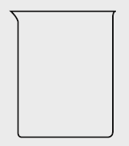

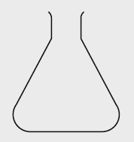



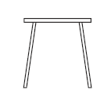

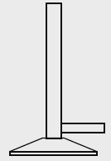
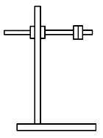

Daily Review
heatproof mat
test tube rack
test tube
beaker
measuring cylinder
conical flask
watch glass
stirring rod
pipe clay triangle
thermometer
tripod
Bunsen burner
retort stand, boss head and clamp
gauze mat
evaporating basin

Slide 3
The Bunsen Burner Year 7 Science

Slide 4
Learning Objectives
CFU
In your own words: what are we going to learn?
Identify the parts of a Bunsen burner and their function.
List the steps used to light a Bunsen burner.
Practice lighting the Bunsen burner.
Activate Prior Knowledge
Think, Pair, Share: What are some of the safety rules we have discussed that relate to the Bunsen burner?
Vocabulary
i·den·ti·fy (verb) to know and say who someone is or what something is

Slide 5
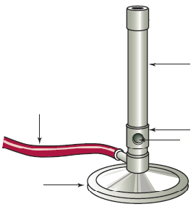
Concept Development
CFU
What is the Bunsen burner commonly used for in the Science laboratory?
Scientists often need to use heat in their experiments.
The Bunsen burner is the most common heat source in the laboratory.
The picture below shows a Bunsen burner. On your sheet, label the parts of the Bunsen burner.
barrel
gas hose
collar
air hole
base

Slide 6
Concept Development
CFU 1
What is the purpose of the air hole?
Scientists often need to use heat in their experiments.
The Bunsen burner is the most common heat source in the laboratory.
CFU 2
What is the function of the collar? (What does it do?)
Each part of the Bunsen burner has a particular function.
Base: Supports the Bunsen burner so it doesn’t tip over.
Air hole: Allows air into the Bunsen burner. More air makes the flame hotter.
Gas hose: Gas from the tap passes through it to the Bunsen burner.
Collar: Can be turned to adjust the size of the air holes.
Barrel: The area where the air and gas mix.
CFU 3
Think, Pair, Share: Why do you need to use a heatproof mat under a Bunsen burner?
barrel
gas hose
collar
air hole
base
Notes:
This will answer the first three questions on the students’ sheets. CFU 3 will answer the fourth (you may need to write the answer on the board).

Slide 7
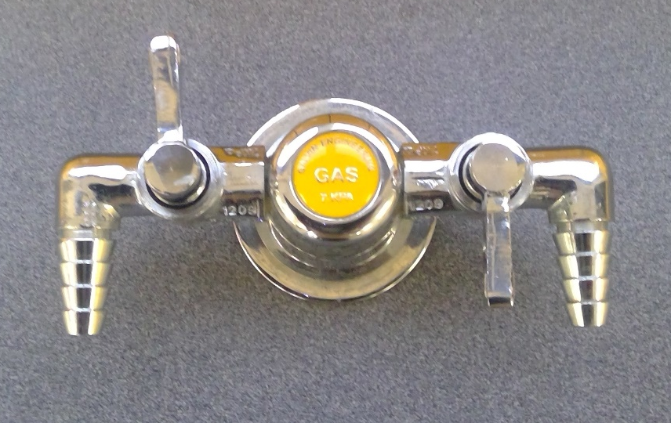
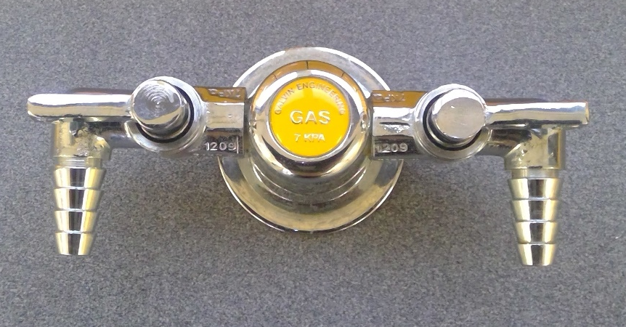
Concept Development
CFU 1
How do you know if the gas tap is turned off?
Scientists often need to use heat in their experiments.
The Bunsen burner is the most common heat source in the laboratory.
CFU 2
Why is it important to turn off the gas at the tap?
Before using a Bunsen burner always check that the gas tap is turned off.
The off position is when the tap is at 90 to the main hose (either pointing at the wall or towards you).
Keeping the gas taps in the off position when not in use will ensure that no gas is released into the Science classroom.
Notes:
This will answer the first three questions on the students’ sheets. CFU 3 will answer the fourth (you may need to write the answer on the board).

Slide 8
Skill Development/Guided Practice
CFU 1
What should you always wear while using a Bunsen burner?
Scientists often need to use heat in their experiments.
The Bunsen burner is the most common heat source in the laboratory.
CFU 2
Why should you tie back long hair and not lean over the Bunsen burner?
There are some important safety rules to follow when using a Bunsen Burner.
Know where the gas shut off is in the room.
Wear safety glasses.
Follow the correct procedure to light the Bunsen burner.
Do not lean over the Bunsen burner.
Tie back long hair.
Do not leave a lit Bunsen burner unattended.
Notes:
These need to be copied onto the students’ sheets.

Slide 9
Skill Development/Guided Practice
CFU 1
What do you do first?
Scientists often need to use heat in their experiments.
The Bunsen burner is the most common heat source in the laboratory.
CFU 2
What is the second step?
CFU 3
What do you do after connecting the rubber hose?
Steps for lighting a Bunsen Burner:
Place the Bunsen burner on a heatproof mat.
Connect the rubber hosing firmly to the gas tap.
Close the air hole by turning the collar.
Light a match and place it above the barrel, with your hand below the flame.
Open the gas tap fully.
The Bunsen burner will be lit with a yellow (safety) flame.
CFU 4
How do you light the Bunsen burner?
CFU 5
What type of flame will you get?
Notes:
These need to be copied onto the students’ sheets.

Slide 10
Relevance
Scientists often need to use heat in their experiments.
The Bunsen burner is the most common heat source in the laboratory.
Knowing the correct procedure for lighting and using the Bunsen burner will help you work safely in the laboratory – it will help prevent accidents and injuries.

Slide 11
Independent Practice
Set up a Bunsen burner at a work station.
When your Bunsen burner is correctly set up, collect a box of matches from the teacher and practice lighting it with teacher supervision.

